Slide 1
What is an OS?
By : Afshin Binesh

Slide 2
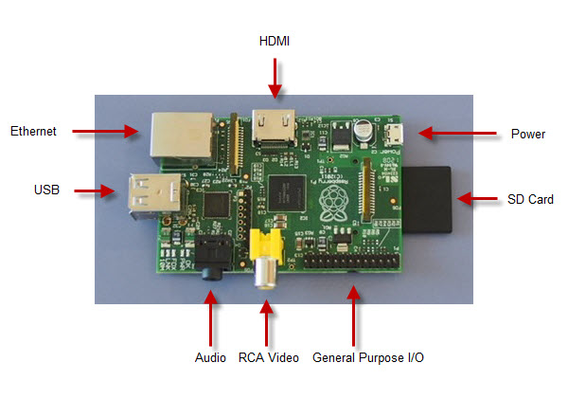
Basic OS

Slide 3
What makes up an OS?
Operating System
Syncroniz-ation
CLI
Security
I/O
File System
scheduling
Threads

Slide 4
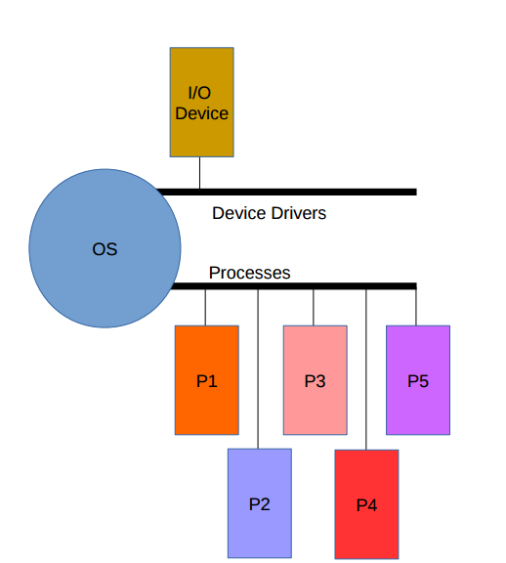
Scheduling

Slide 5
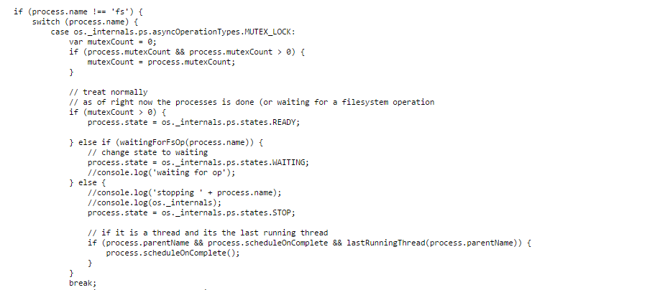
Scheduling

Slide 6
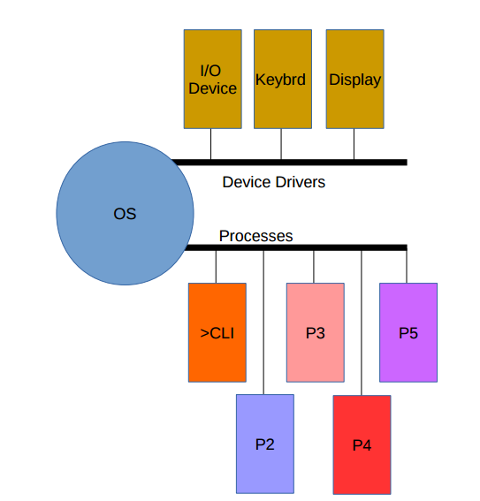
CLI

Slide 7
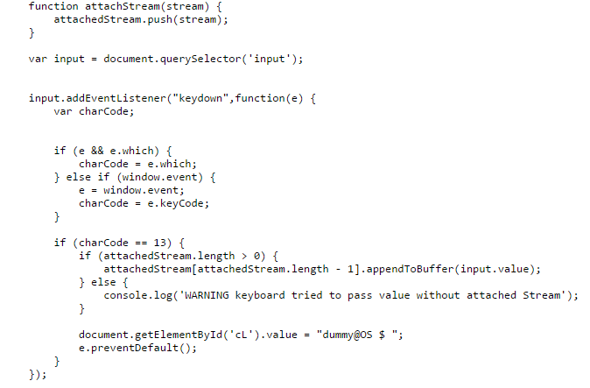
CLI

Slide 8
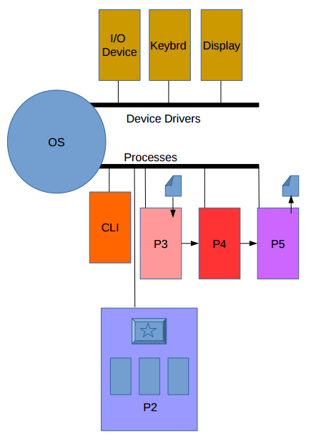
Threads

Slide 9
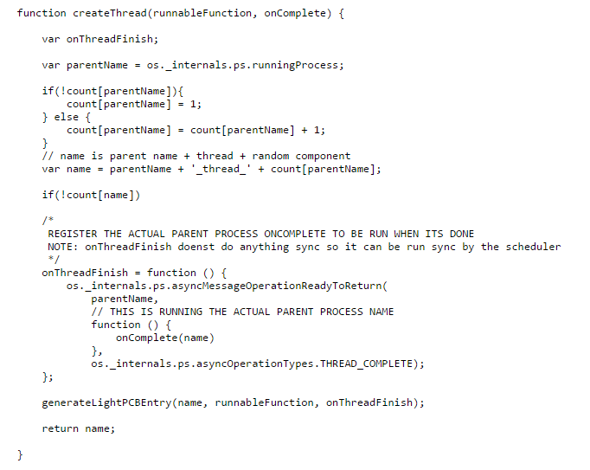
Threads

Slide 10
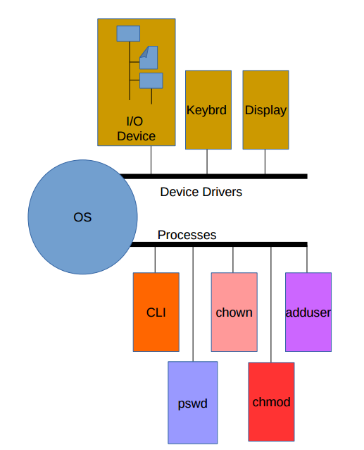
Security

Slide 11
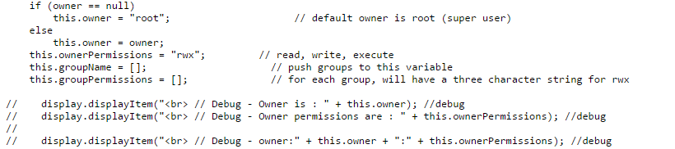
Security

Slide 12
Thank you very much for all your help!

